Slide 1
Park n' Go Final Proposal
Rajdeep Singh
Alexander Huttunen
Jisoo Jung
Yaning (Nina) Yang

Slide 2
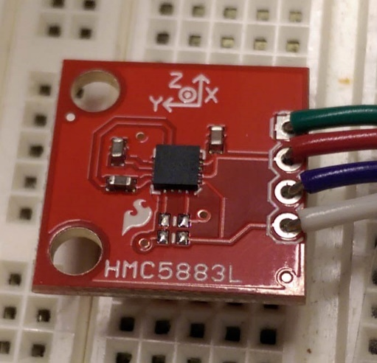
Selected Sensors
Magnetometer

Slide 3
Problem
Underutilized parking space in underground garage
Affects surrounding residence price
Knowing the parking availability in the parking garage
Detecting whether or not an individual parking spot is occupied
Must be
Cost Effective
Low Power
Reliable

Slide 4
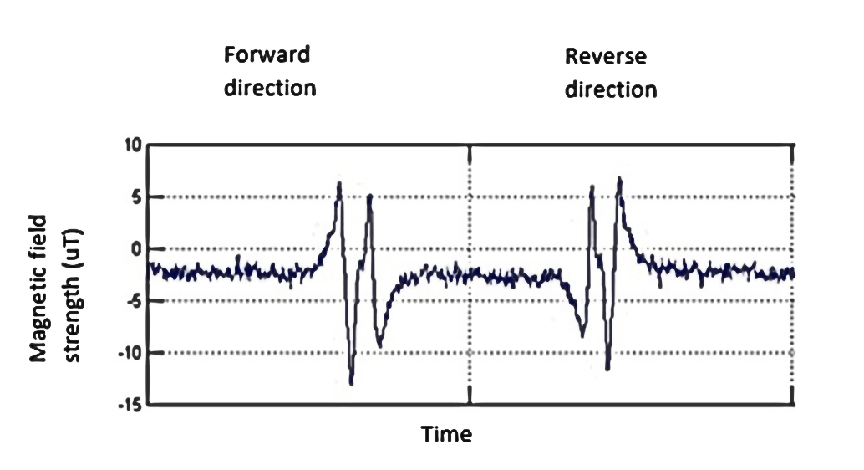
Sensor: Magnetometer
Measures disturbances in the magnetic field
Almost all vehicles are made of or contain metal of some sort
Place one at the end of each parking spot to detect the car passing into the spot or out.
NXP (a semiconductor manufacturer) has tested this use case and found that it works. (see right)
Car Driving Over Magnetometer
http://blog.nxp.com/connected-car/howto-detect-vehicle-presence-or-movements-with-magnetometers/

Slide 5
Limitations/ Assumption: Magnetometer
Assumptions:
Vehicle must be metal of some kind
Vehicle height is relatively low (less than 3 feet)
Vehicle drives over the sensor
Limitations:
If the car enters the parking spot from an unexpected direction

Slide 6
Strength
Cost efficient, estimated to cost less than $10 per parking spot
Environment
Weather
lighting
Location
Parking garage
Street parking
Orientation
Straight/ Parallel/ Diagonal

Slide 7
Risk: Magnetometer
Magnetometer's data shows some fluctuations, which needed to be filtered somehow. The plot below shows an example of this.
Needs continuous power to be able to be ready for a vehicle to pass over
Possibility of only having one shot at detecting when a car drives over the sensor

Slide 8
Sensor Comparison (using an Arduino Yun and a piece of metal equipment)

Slide 9
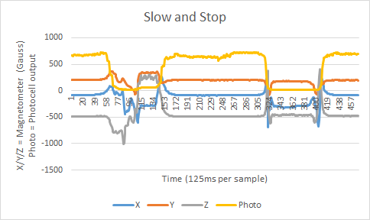
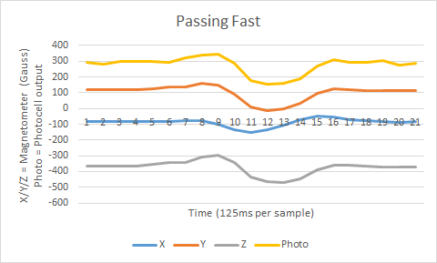
Real Car Data
Much smaller amplitude
Mirrored signals
X-axis is lower when car is over sensor

Slide 10
Design System
Magnetometer
I2C
Si4010 Microcontroller
GNURadio
Graphical User Interface
Frequency Shift Keying (FSK) Signals
Web Server and Database

Slide 11
Milestones
Trying the magnetometer out with an actual vehicle to assess feasibility
Achieving I2C communication between the Si4010 and magnetometer and processing the signal to detect a car
Radioing a signal back to the Pi from the Si4010 and processing it to the Pi

